Slide 1
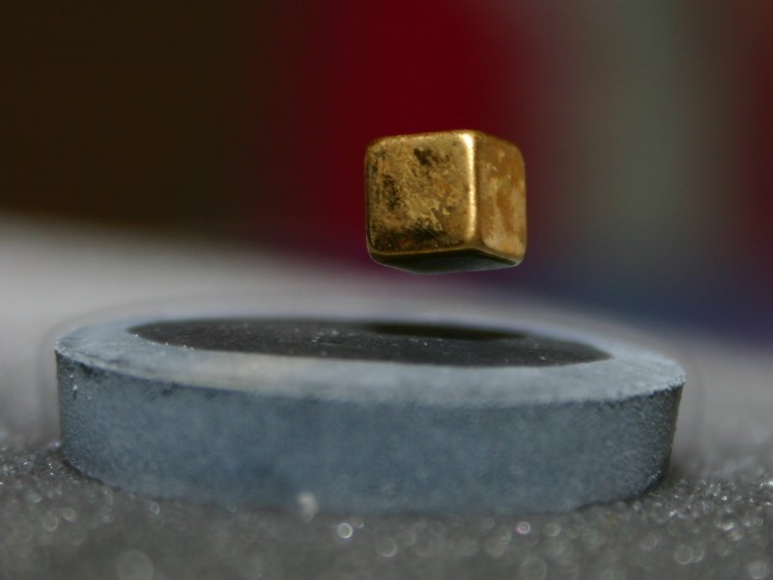
Superconductivity

Slide 2
Topics to be covered
Introduction
Properties of Superconductors
Critical Temperature
Critical Magnetic Field
Meissner Effect
Persistent Current
Critical Current
Isotope Effect
Numerical Problems

Slide 3
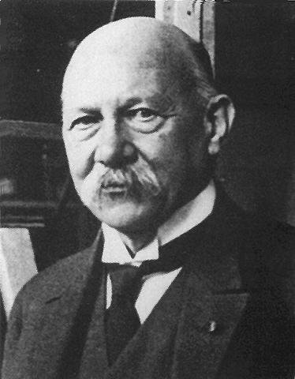
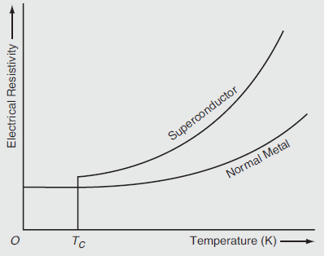
Introduction
The phenomenon of superconductivity was first discovered by Kammerlingh Onnes in 1911.
He found that electrical resistivity of some metals, alloys and compounds drops suddenly to zero when they are cooled below a certain temperature.
This phenomenon is known as superconductivity and the materials that exhibit this behaviour are called as superconductors.

Slide 4
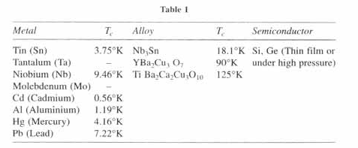
Critical Temperature
As temperature decreases, conductivity increases (electrical resistivity decreases), but it was found for some materials that suddenly at a particular temperature called transition temperature or critical temperature (T_{C}), the conductivity becomes infinite, that is, the resistance suddenly falls to zero.
Examples of superconductors
Tin, lead, Mercury, Niobium, Cadmium, Aluminium.
Many good conductors like Ag, Au. Cu are not superconductors.
Superconducting elements can be metal, alloy or semiconductor.

Slide 5
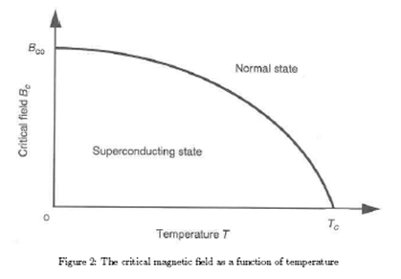
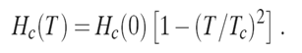
Critical Magnetic Field
By the application of external magnetic field, the superconducting state can be destroyed and normal state can be restored.
The critical magnetic field H_{C} refers to the maximum magnetic field strength below which a material remains superconducting.
H< H_{C},T<T_{C} ----- superconducting state
H> H_{C},T>T_{C} ----- normal state
The critical or the threshold value of the applied field H_{C} for the destruction of superconductivity is a function of temperature (T).
The critical magnetic field H_{C} will be zero at T=T_{C}
The critical field varies with temperature according to the parabolic law

Slide 6
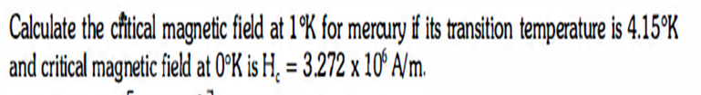
Problem 1

Slide 7
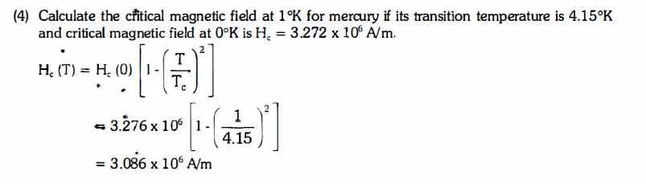

Slide 8
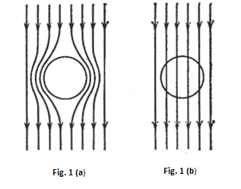
Meissner effect
An important property of the superconducting phase is the repulsion of magnetic flux lines from the bulk of superconductor. It is called Meissner effect.
When a specimen is placed in a magnetic field, the magnetic flux lines pass through it (Fig. 1b, normal metal).
Now, if the temperature is decreased below the transition temperature (Tc), it expels all the magnetic flux lines from inside of the specimen (Fig. 1a, superconductor).
Hence, we get
where
M is the intensity of magnetisation
H is applied magnetic field.
Now, magnetic susceptibility
Since diamagnetic materials have negative magnetic
susceptibility, the specimen becomes an ‘ideal
diamagnetic’ in superconducting state.

Slide 9

The Meissner Effect
superconductors push out magnetic fields
T > T_{c}
T < T_{c}
The value of magnetic susceptibility for superconductor is negative

Slide 10
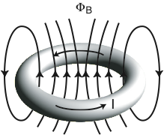
Persistent Current
A steady current that flows through a superconducting ring without any decrease in strength even after the removal of the field is persistent current.
Critical current (I_{c})
The maximum value of current flowing through the superconductor at which superconductivity is destroyed is called critical current (I_{c}).
Notes:
this has been found after observing the current not decay for years! So we can for now assume that the resistivity is zero.
This is useful but also quite boring and expensive.
now a few other phenomena

Slide 11
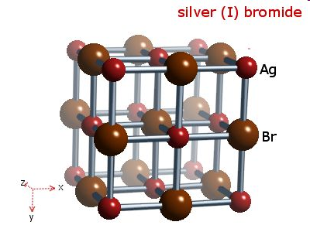
Isotope effect
The critical temperature Tc of superconductors varies with isotopic mass according to the relation

Slide 12
Problem 2
The critical temperature for Hg with isotopic mass of 199.5 is 4.185 K. What will be the critical temperature when the isotopic mass is increased to 203.4?

Slide 13
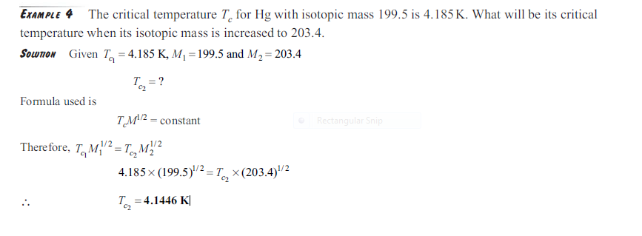

Slide 14
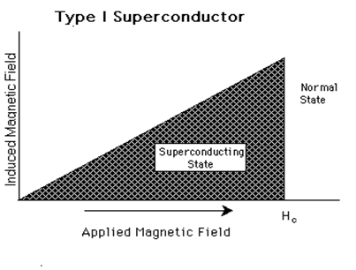
TYPES OF SUPERCONDUCTORS
There are two types of superconductors
Type-I superconductors
Type-II superconductors
Type I superconductors exhibit complete Meissner effect.
Type I superconductors are also called Soft Superconductors.
The normal state will be restored at H> H_{C.}
Examples : Cd, Zn, Ga

Slide 15
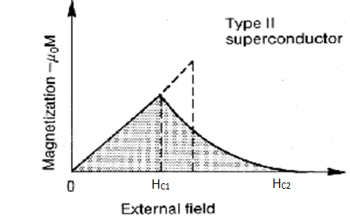
TYPE-II SUPERCONDUCTORS
A Type II superconductor has two critical fields H_{C1}<H_{c}<H_{C2}.
Type II superconductors are also called Hard Superconductors.
They do not exhibit complete Meissner effect.
Type II superconducting specimen has superconducting electrical properties upto H_{C2} but between H_{C1} and H_{C2} the magnetic flux density B≠0, the flux starts to penetrate the specimen at H_{C1} and Meissner effect is said to be incomplete.
Examples : Nb₃Sn, Nb₃Ge, Nb₃Al, NbTi

Slide 16
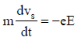
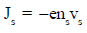
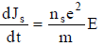
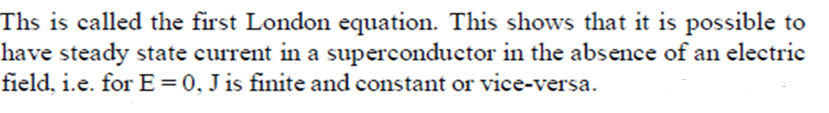
London Equations
In 1935, F. London and H. London developed London equations to explain the
zero resistance and Meissner effect in superconductors.
i) A superconductor is composed of two distinct types of electrons, normal electrons and superelectrons.
ii) The normal electron behaves in a usual manner. However the
superelectrons behave in much different way.
n = n_{s} + n_{n}
n_{s} and n_{n} respectively are the densities of normal electrons and superelectrons.
The equation of motion for the superconducting electrons in the presence of applied electric field is given by
(1)
(2)
Differentiating equation (2) and using in equation (1) we get,
(3)

Slide 17
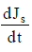
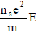
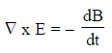
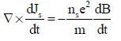
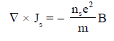
Taking curl on both side of equation( 3)
(4)
(5)
We know that,
Using 5 in 4 we get,
Or

Slide 18
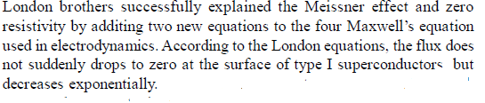
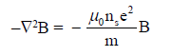
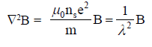
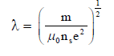
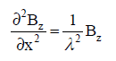
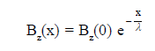
Explanation of flux penetration
using London second equation, we get
Taking curl both sides, we get
Using standard identiy , we get
The one dimension form of above equation
The solution of one dimension equation

Slide 19
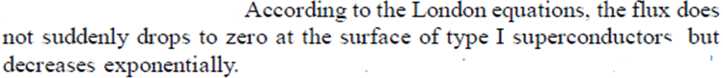
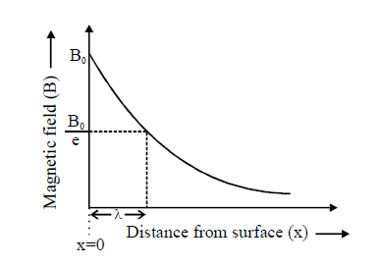
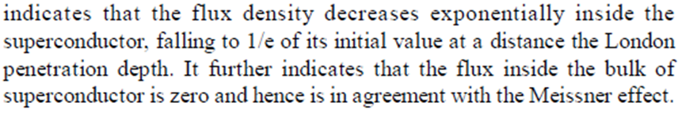
The London penetration depth is given by

Slide 20
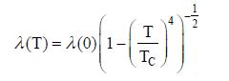
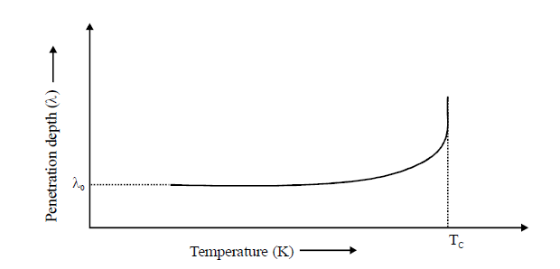

Slide 21
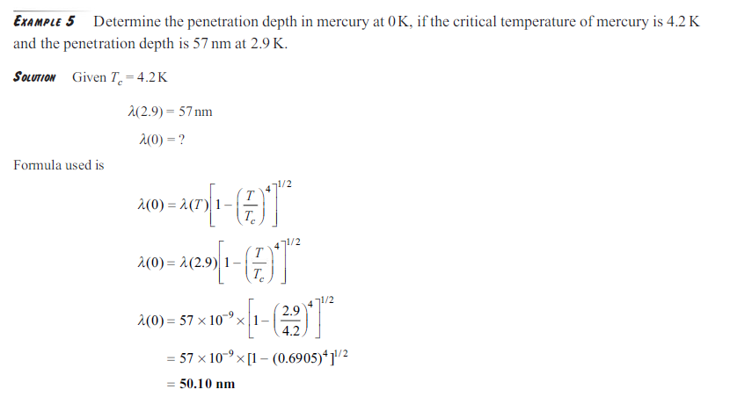

Slide 22
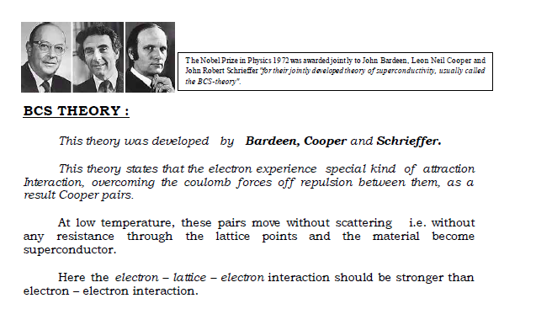

Slide 23
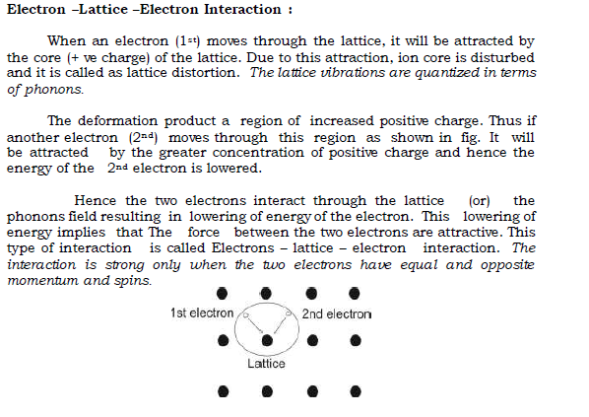

Slide 24

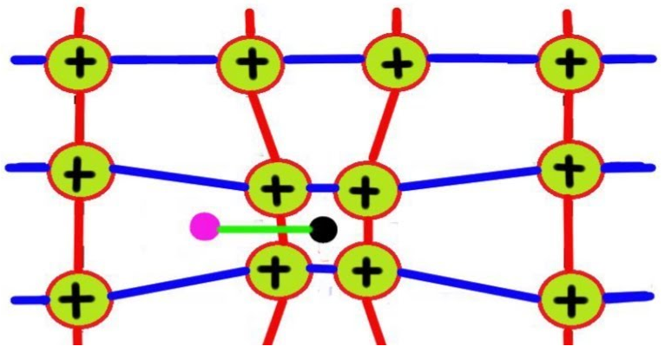
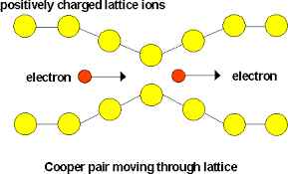

Slide 25
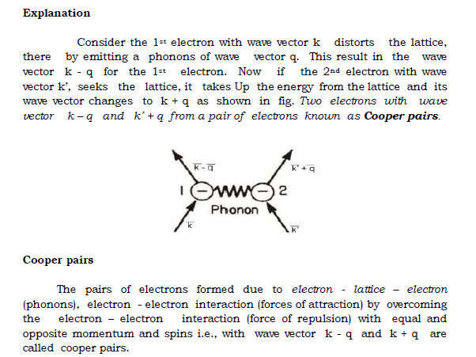

Slide 26
Cooper pair binding energy
The superconductivity occurs when an attractive interaction between two electrons due to phonon exchange dominates the usual repulsive interaction. This is the fundamental postulate of the BCS theory.
The energy of the pair of electrons in bound state is less than the energy of the pair in free state.
This difference of energy is called binding energy of the Cooper pairs. It means by applying this amount of energy we can break this pair.
The pairing is complete at T = 0 K and completely broken at T = Tc.
It was observed that the binding energy of the Cooper pair is maximum when electrons forming the pair have opposite momenta and spins.
Cooper pair binding energy or the energy gap is Eg = 3kTc
where k is the Boltzmann constant.

Slide 27
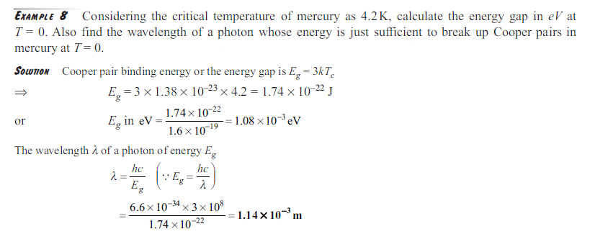

Slide 28
High Temperature (T_{C}) Superconductors
The high temperature superconductors represent a new class of materials, those bear extraordinary superconducting and magnetic properties.
These types of superconductors have great potential for wide ranging technological applications.
Superconducting transition temperature greater than 77 K.
Examples
(i) Yttrium barium copper oxide (YBa₂Cu₃O₇) with 92 K as Tc.
(ii) Bismuth strontium calcium copper oxide {(BiPb)₂Sr₂Ca₂Cu₃O_{x}} with 105 K as Tc.
(iii) Thallium barium calcium copper oxide (TlBa₂Ca₂Cu₃O_{y}) with 115 K as Tc.
(iv) Mercury barium calcium copper oxide (HgBa₂Ca₂Cu₃O_{y}) with 135 K as Tc.

Slide 29
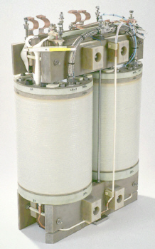

APPLICATIONS
Transformers for railway power supply

Slide 30


Powerful superconducting magnets

Slide 31
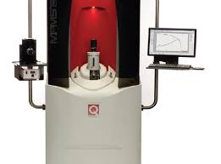
SQUID
The superconducting quantum interference device (SQUID) may be configured as a magnetometer to detect incredibly small magnetic fields, i.e., small enough to measure the magnetic fields in living
organisms.

Slide 32

Maglev Trains

Slide 33
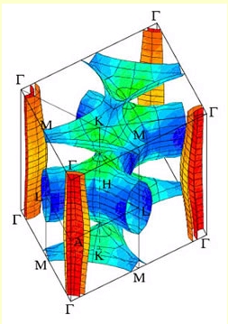
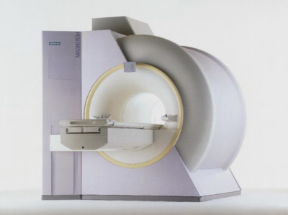
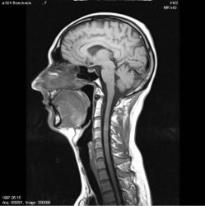
Medical NMR tomography equipment

Slide 34

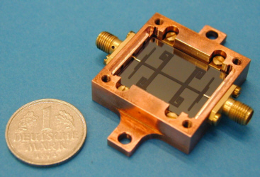
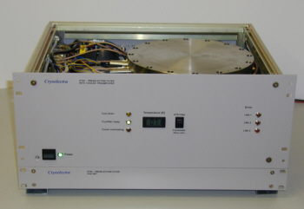
High frequency filters for wireless communications

Slide 35
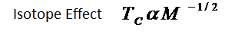
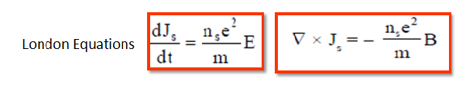


SUMMARY

Slide 36
THANK YOU

